Slide 1
Stock Prediction –
A Neural Network Approach
Karl Nygren, 28th March 2004
Presenter: Tsung-Jung Tsai (蔡宗容)
Date: Feb. 14, 2008

Slide 2
Abstract (1/3)
Predicting stock data with traditional time series analysis has proven to be difficult. An artificial neural network may be more suitable for the task. Primarily because no assumption about a suitable mathematical model has to be made prior to forecasting. Furthermore, a neural network has the ability to extract useful information from large sets of data, which often is required for a satisfying description of a financial time series.
Notes:
使用傳統方法去預測股價已經被證明是困難的事。類神經網路或許可以勝認這個工作。首先，因為對一個數學模型必須在做預測前先決定下沒有任何假設，而類神經網路有能力能夠從大資料集合中取出有用的資訊，這些資料對一個財務時間序列的充分描述是經常需要的。

Slide 3
Abstract (2/3)
This thesis begins with a review of the theoretical background of neural networks. Subsequently an Error Correction Neural Network (ECNN) is defined and implemented for an empirical study. Technical as well as fundamental data are used as input to the network. One-step returns of the Swedish stock index (瑞典股價指數) and two major stocks of the Swedish stock exchange (瑞典證券交易所) are predicted using two separate network structures. Daily predictions are performed on a standard ECNN whereas an extension of the ECNN is used for weekly predictions.
Notes:
這篇論文首先對類神經網路的理論背景做一個回顧。隨後會定義誤差校正神經網路(ECNN)並實做一個經驗學習。技術和基本資料當作網路輸入，瑞典股價指數和瑞典證券交易所兩個主要指數的一步報酬，使用兩個分開的網路架構來預測。每日預測使用標準的ECNN來執行，而ECNN的延伸則是用作每週的預測。

Slide 4
Abstract (3/3)
In benchmark comparisons, the index prediction proves to be successful. The results on the stocks are less convincing, nevertheless the network outperforms the naive strategy.
Notes:
在評估基準值的比較，指數的預測被證明是有效的。這個結果在股市裡缺乏說服力，然而這個網路勝過樸素策略。

Slide 5
Neural Network
The human brain consists of an estimated 10 billion neurons (nerve cells) and 6000 times as many synapses (connections) between them
A neuron in itself is relatively slow compared to a silicon logic gate.
However, this amazing amount of neurons and synapses suites as compensation. Thus the brain operates as nothing less than a complex, non-linear and parallel computer.
Notes:
神經網路的基礎是起始於科學界的生物學。人類大腦估計有100億個神經元及6000倍那麼多的突觸位於神經元之間。一個神經元本身與矽晶邏輯閘比較上相對反應慢，然而神經元及突觸的驚人數量能加以補償。因此，大腦運作不會比一個複雜、非線性和平行的電腦來的慢。隨著這個概念的提出，我們準備以數學上的方式來描述神經網路。

Slide 6
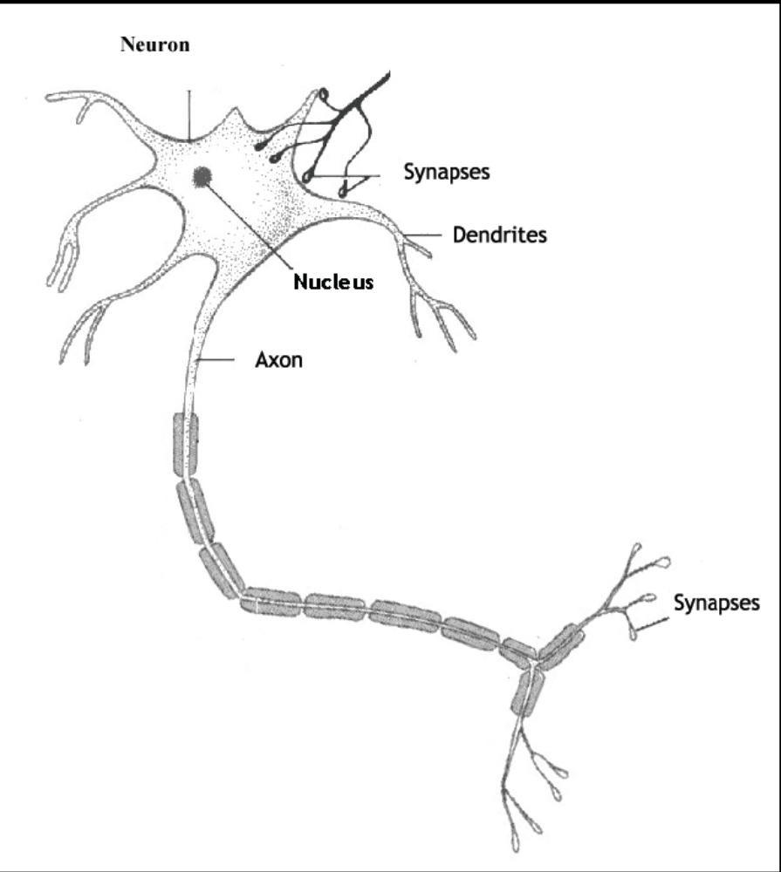

The single Neuron
↓stimulus
↓receptors
↓neural network
↓evaluation
↓effectors
↓response
Notes:
當從環境接收到刺激時會啟動程序。感覺接收器把這個訊息轉換成電子脈衝，並傳遞到神經網路(神經元和突觸)，神經元會將其處理後決定反應，送出訊號到受動體。

Slide 7
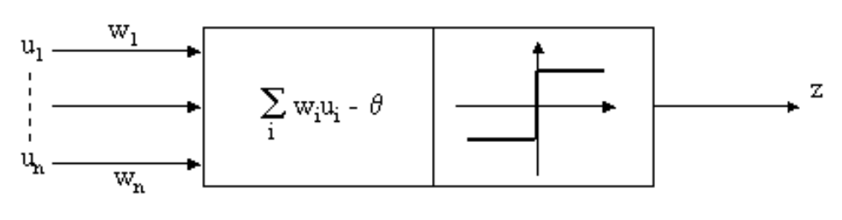
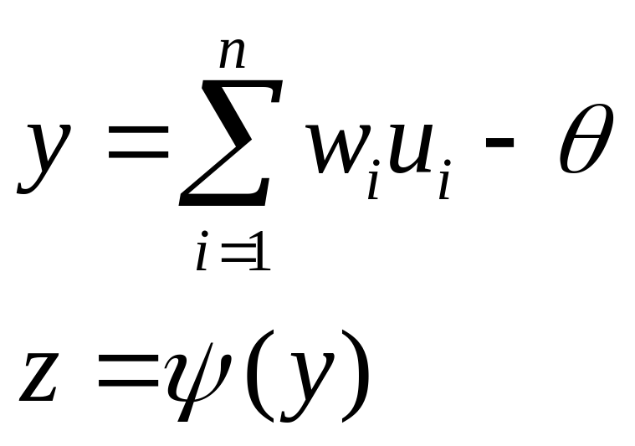
Z is either continues or binary valued
Depending on the activation function
Notes:
其中 y 是淨輸入，z 是活化函數

Slide 8
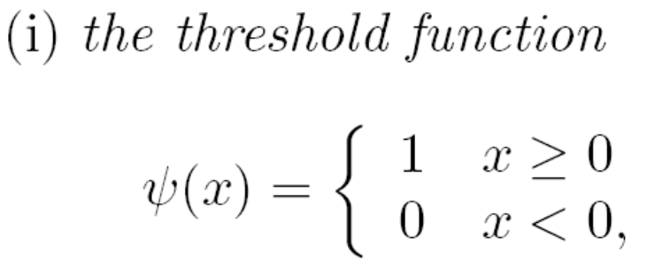
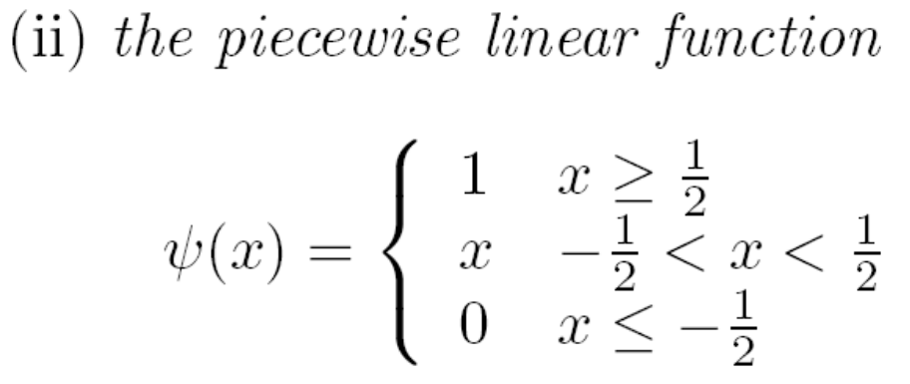
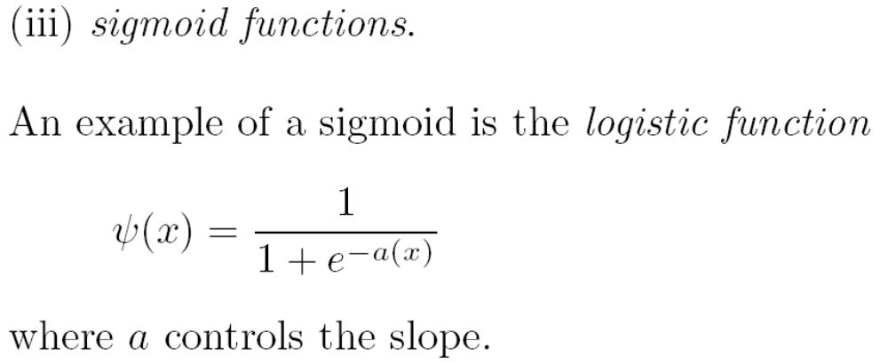
Activation Functions (1/2)
Notes:
最受歡迎的

Slide 9
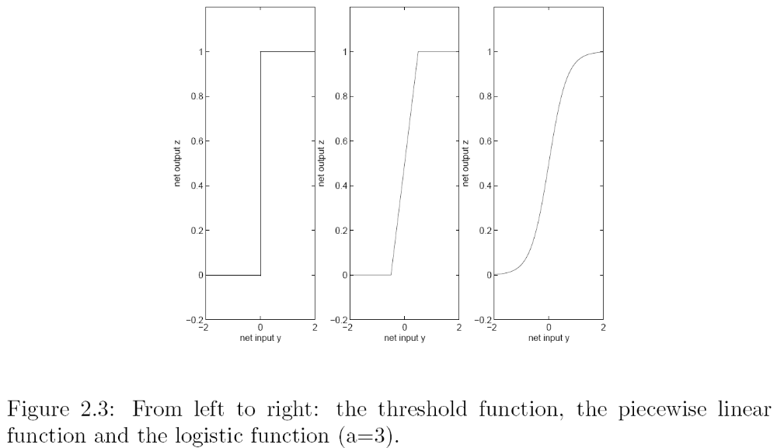
Activation Functions (2/2)

Slide 10
Network Structures
Feed-forward Network (向前式網路)
  A single layered network
  an input layer of source nodes and an output layer of neurons.
  A multi-layer network has in addition one or more hidden layers of hidden neurons
Notes:
網路架構的重要性不能夠被低估。因為在學習演算法與網路結構中有很緊密的關係。

Slide 11
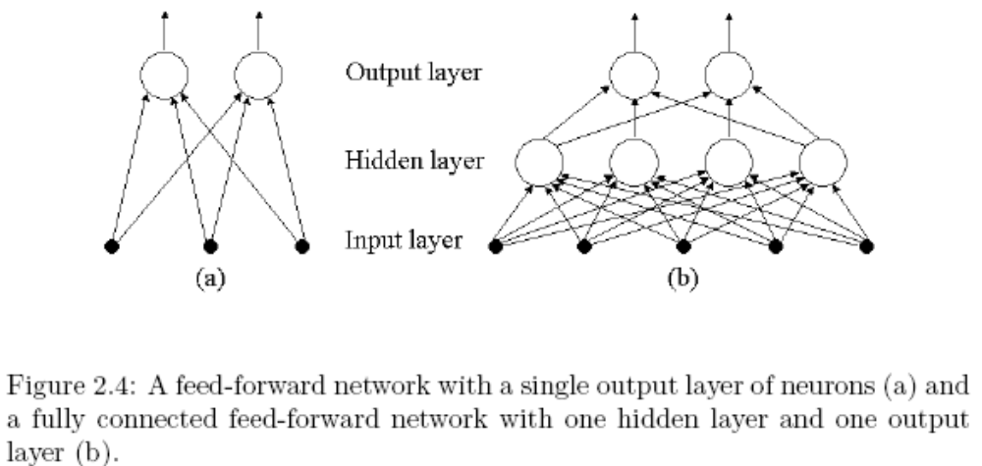
Network Structures
Notes:
額外的隱藏神經元可增加神經網路從輸入資料取高階的統計能力。這是一個重要的特性，特別當有大的輸入層時候。再者，如果某一層的每一個節點與相鄰下一層的每一個節點都有連接，則稱為完全連接；反之，若至少有一個突觸沒有連接，則稱為部份連接。

Slide 12
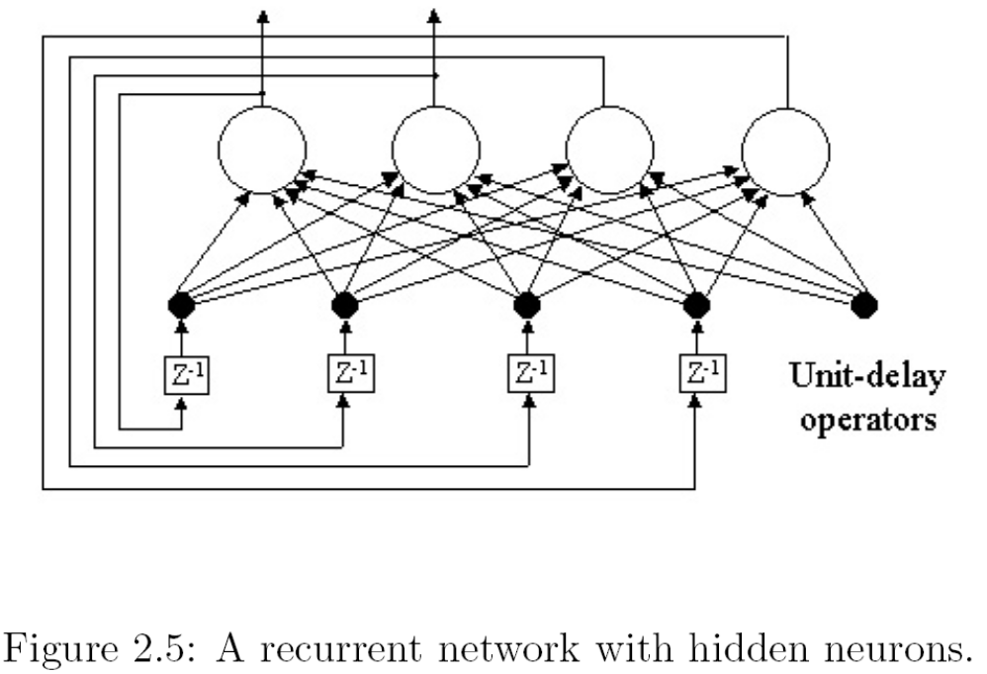
Network Structures
Recurrent Network (反饋式網路)
  At least one feedback loop exists
Notes:
網路架構的重要性不能夠被低估。因為在學習演算法與網路結構中有很緊密的關係。

Slide 13
Neural Network in Finance
Neural Network can be applied to all sorts of financial problems, not only stock prediction tasks.
Forecasts of yield curves, exchange rates, bond rates etc. are common.

Slide 14
Motivation for Neural Network
Stock data is highly complex and hard to model, therefore a non-linear model is beneficial.
A large set of interacting input series is often required to explain a specific stock, which suites neural networks.
Notes:
在股票預測中，對類神經網路的主要動機有兩個部份
股票資料是高度複雜且難以建模，因此一個非線性模型是有利的
一大堆的互動輸入序列是經常需要來解釋特定的股市

Slide 15
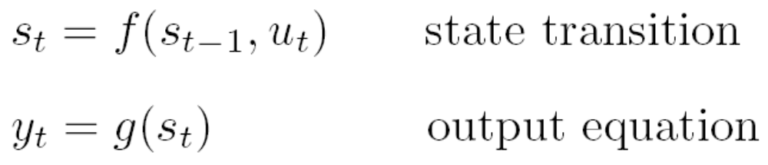
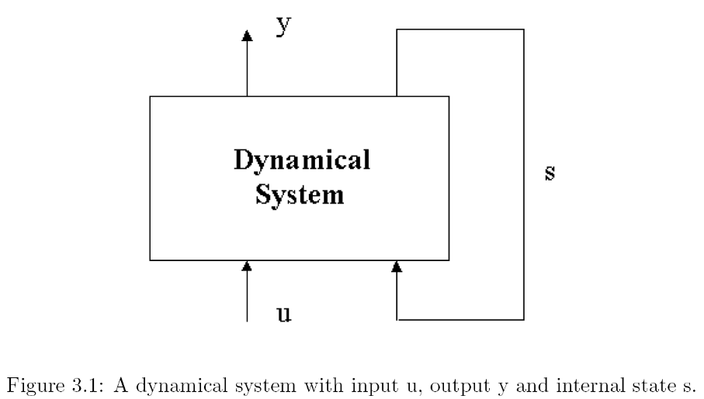
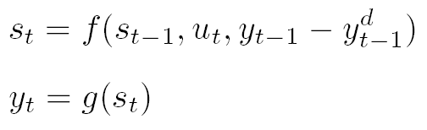
Error Correction Neural Networks
A basic dynamical recurrent system can at time t be expressed as follow:

Slide 16
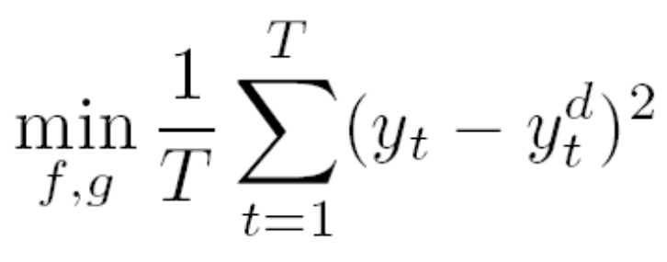
Define the Functions f and g
The search for an optimized solution of
Define f and g :
where T is the number of patterns
y^{d} denotes observed data

Slide 17
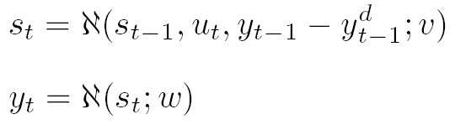
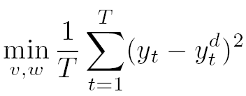
Implemented As a NN
Naturally the optimization problem transforms to

Slide 18
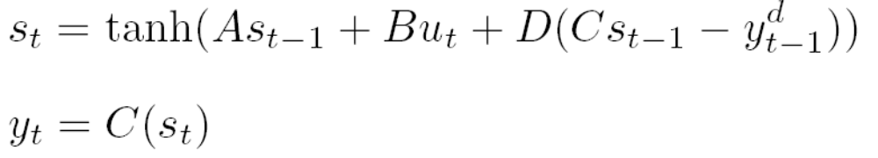
Formulate the System
Both matrix A and DC could code the autoregressive structure of the system.

Slide 19
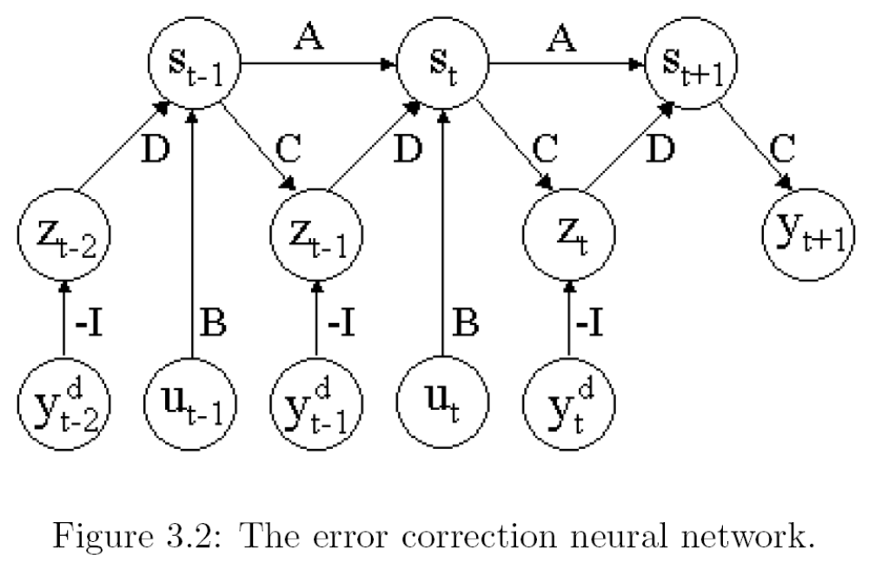
Formulate the System

Slide 20
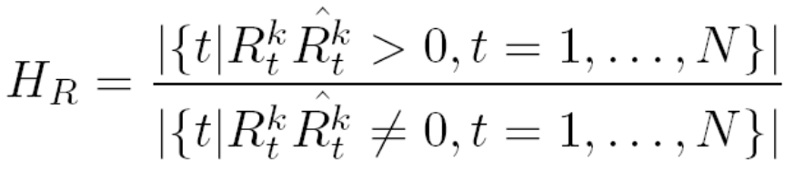
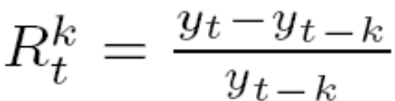
Performance Measures
Three frequently used measures, namely hit rate, return on investment and realized potential, are defined below.
Hit rate H_{R}:
H_{R} indicates how often the algorithm produces a correct prediction.

Slide 21
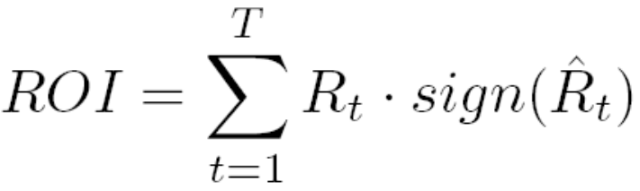
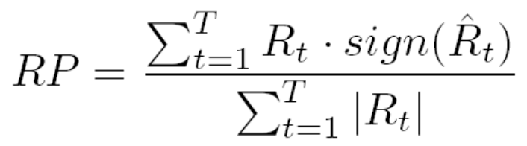
Performance Measures
The return on investment ROI take into account not only the correctness of the sign, but also the quality of the actual return.
Realized potential RP:

Slide 22
Data Series
For all predictions the following four time series were used as raw input:
− Closing price y
(price of the last fulfilled trade during the day)
− Highest price paid during the day, yH
− Lowest price paid during the day, yL
− Volume V
(total amount of traded stocks during the day)

Slide 23
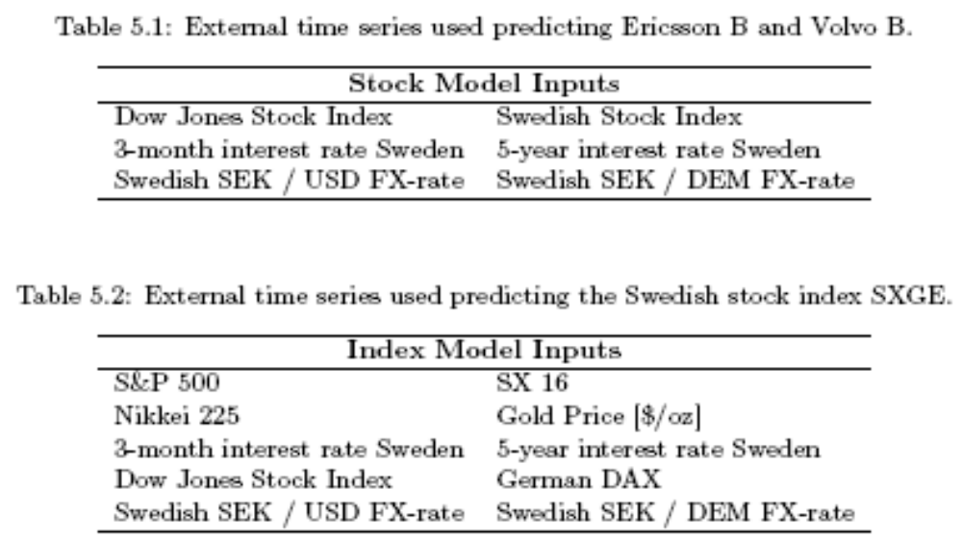
External inputs

Slide 24
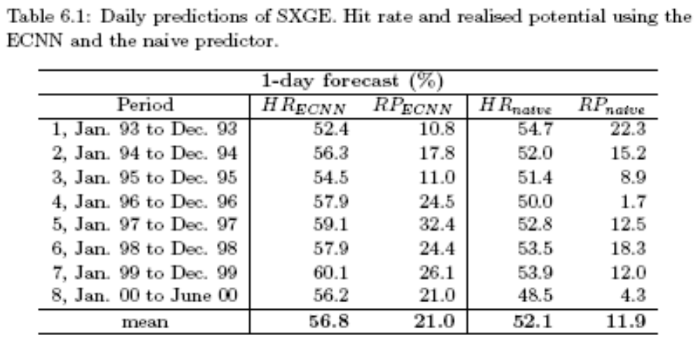
Daily Predictions-1

Slide 25
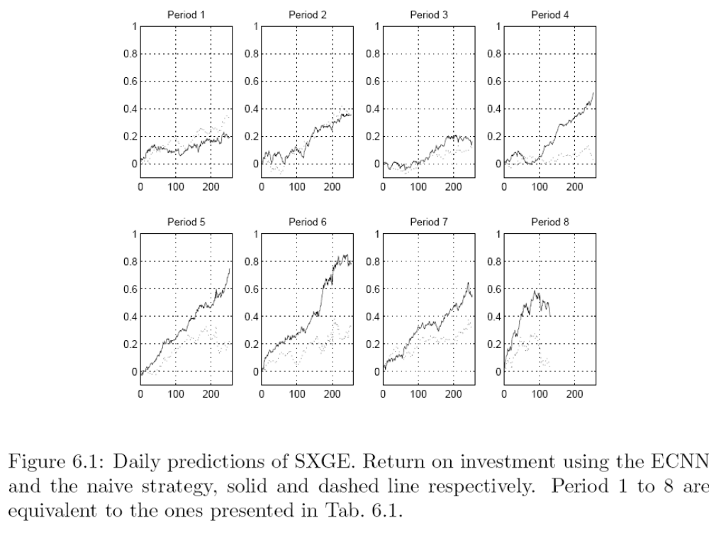
Daily Predictions

Slide 26
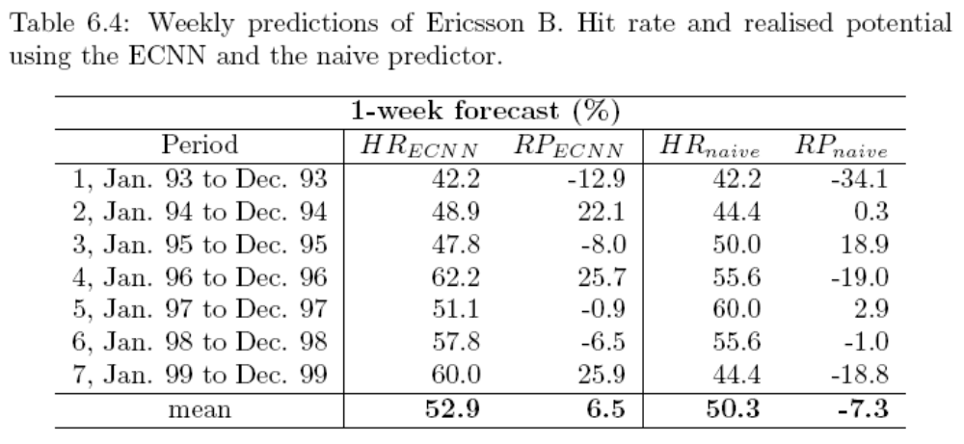
Weekly Predictions-1

Slide 27
